Slide 1

DEPARTMENT OF COMPUTER SCIENCE AND ENGINEERING
JAVA FULLSTACK DEVELOPMENT
Hospital Management System
JAVA FULLSTACK-03
DEVELOPED BY
43111603 – Aravind Nathan S
BE CSE

Slide 2
ABSTRACT
• Hospital Management System (HMS) is a web-based application designed to manage hospital operations efficiently.
• It automates tasks such as patient registration, doctor management, appointments, and reports.
• Reduces manual paperwork and improves workflow

Slide 3
EXISTING SYSTEM
• Hospitals use manual records or basic software for operations.
• Challenges:
Time-consuming patient record handling
High risk of errors in medical history and appointments
Poor accessibility and slow communication
• Limited reporting and analytics.

Slide 4
PROPOSED SYSTEM
• Web-based Hospital Management System using Spring Boot (backend) or H2/MySQL database, and HTML/CSS/JS frontend.
• Features:
Patient & doctor management
Appointment scheduling
Reports & analytics
User roles (Admin, Doctor, Patient)
• Provide a simple and user-friendly experience

Slide 5
ADVANTAGES
• Efficient management of hospital data
• Quick access to patient records and doctor schedules
• Reduced paperwork and manual errors
• Supports multiple users and roles

Slide 6
DISADVANTAGES
Requires computer and internet access
Initial setup and maintenance costs
Training required for staff unfamiliar with software

Slide 7
HARDWARE REQUIREMENTS
• Processor: Intel Core i3 or higher
• Doctor RAM: 4 GB minimum
• Storage: 100 GB HDD/SSD
• Network: Internet connectivity for web access

Slide 8
SOFTWARE REQUIREMENTS
• Backend: Java 24, Spring Boot 2.7.x
• Database: H2 (for testing) / MySQL (for production)
• Frontend: HTML, CSS, JavaScript,
• IDE: VS Code / IntelliJ IDEA / Eclipse
• Build Tool: Maven

Slide 9
MODULES
Admin Module – Manages doctors, patients, appointments, and reports.
Doctor Module – Views appointments, patient history, and adds medical
records.
Patient Module – Registers, views appointments, and accesses reports.
Appointment Module – Schedule, update, and track appointments.

Slide 10
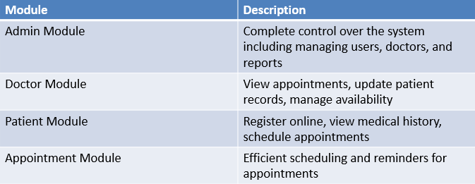
MODULE DESCRIPTION

Slide 11
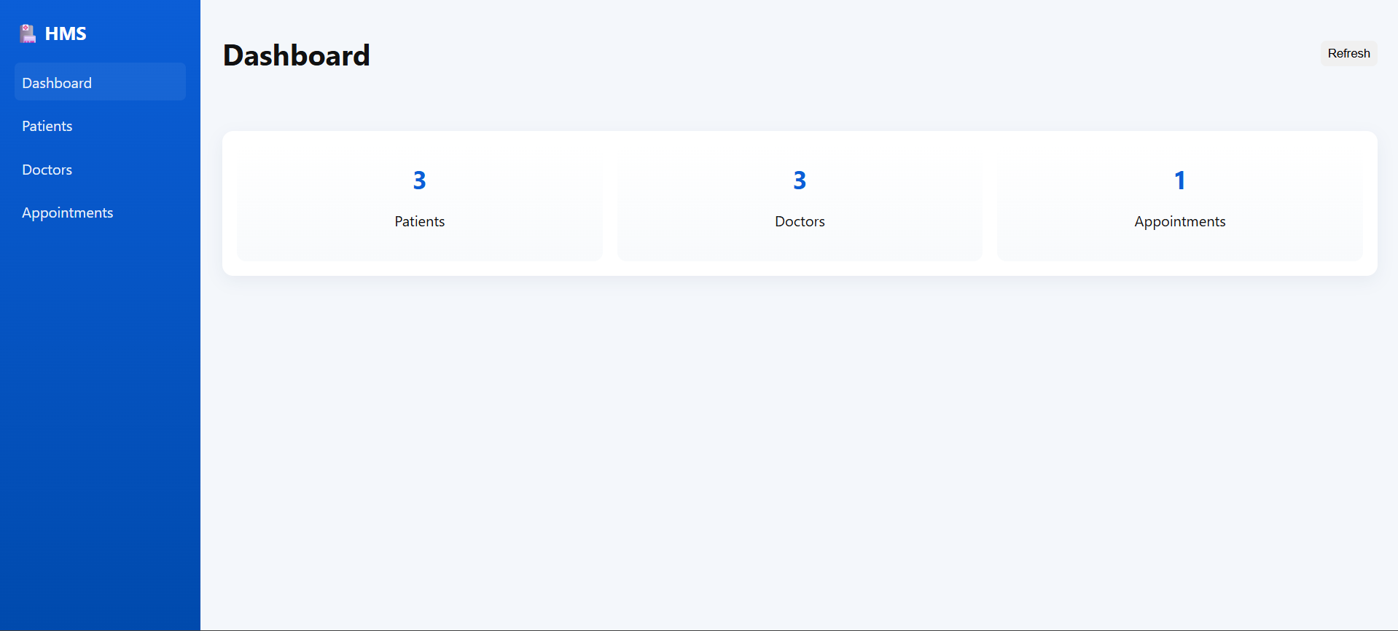
SCREEN SHOTS

Slide 12
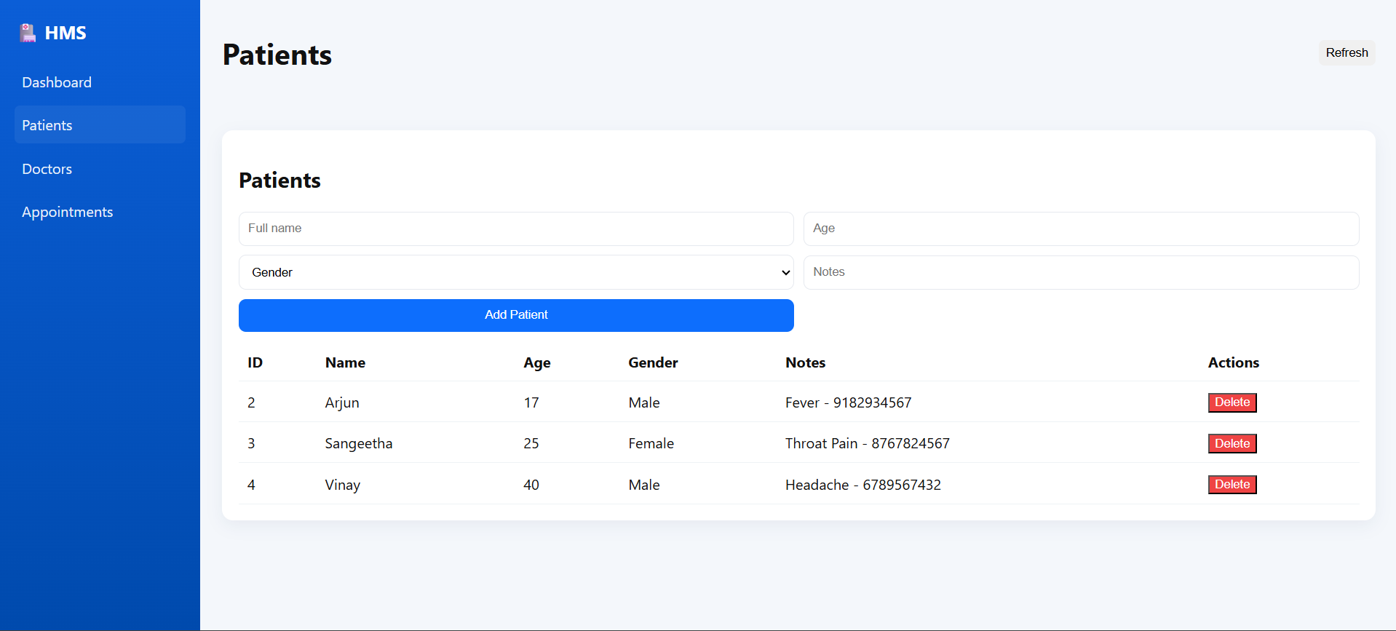
SAMPLE OUTPUT
Fig: Home Page

Slide 13
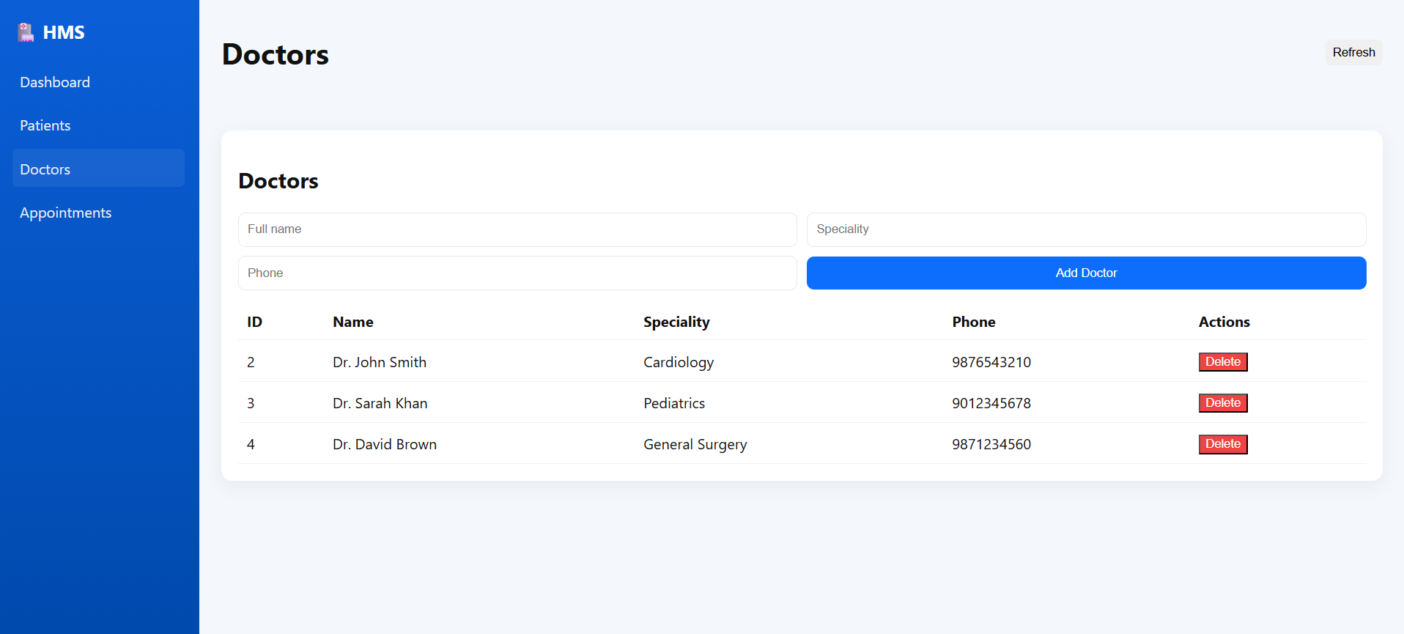
SAMPLE OUTPUT
Fig: Cart Page

Slide 14
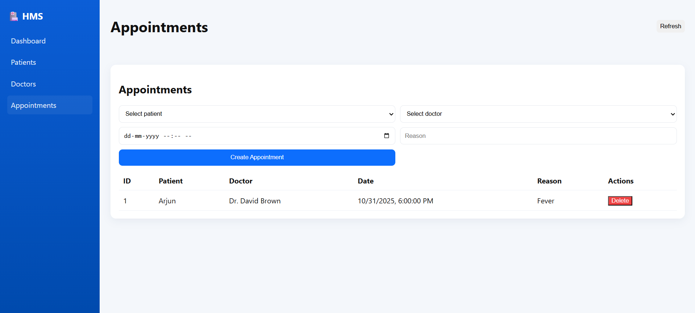
SAMPLE OUTPUT

Slide 15
CONCLUSION
• The HMS project simplifies hospital management, reduces errors, and improves efficiency.
• It allows real-time access to data for doctors, patients, and admin.
• Scalable and can be enhanced with additional features such as online payment, email notifications, and analytics dashboards.

